Slide 1

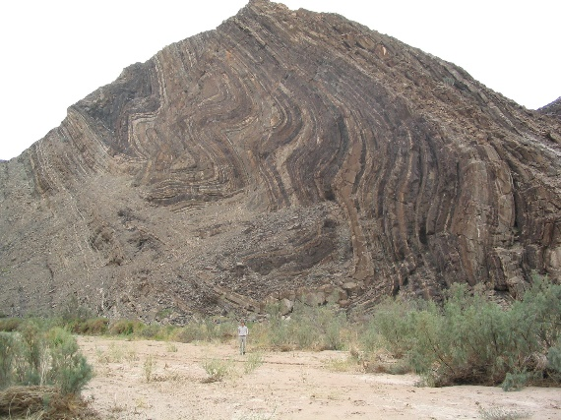
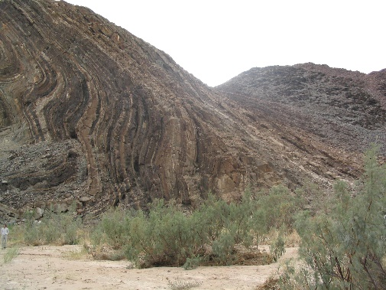
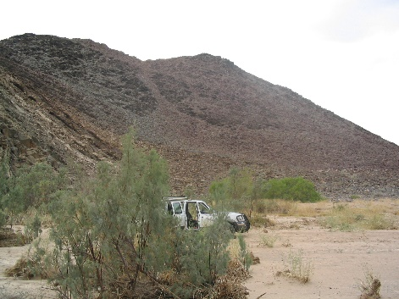

Spatial Agents for Geological Surface Modelling
Eric A. de Kemp* – Geological Survey of Canada
2003 Ugab Fold Belt, Namibia
20th Annual Conference
IAMG2019
State College, Pennsylvania, USA
*eric.dekemp@canada.ca
Notes:
In the domain of 3D geological modelling I have been looking at what I think is an interesting framework for moving into more complex modelling tasks. Modelling geological features requires the construction of bounding surfaces using various structural and stratigraphic constraints. This can be accomplished many ways, but one way is through the use of Spatial Agents.
Spatial Agents are being used to model complex natural and artificial systems in many domains with some success.
Good examples include protein folding from biomedical, crowd modelling from urban planning and in the future autonomous traffic applications with semi- and fully autonomous vehicles.

Slide 2
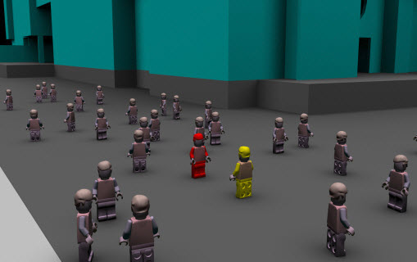
Spatial Agents
Software entities:
Semi-autonomous
Beliefs and behaviors
Non-centralized
Communicate (others, environment)
Solve complex problems (efficiently)
http://www.geosimulation.org
Dr. Paul M. Torrens,
Center for Urban Science + Progress,
New York University
20th Annual Conference
IAMG2019
State College, Pennsylvania, USA
Notes:
Spatial Agents are being used to model complex natural and artificial systems in many domains with some success.
Agents have been used to solve complex Urban planning issues for traffic and pedestrian modelling.
Other examples include protein folding from biomedical, and the use of Smart Drones and future autonomous vehicles will have spatial agent based navigation systems with swarm technologies.

Slide 3
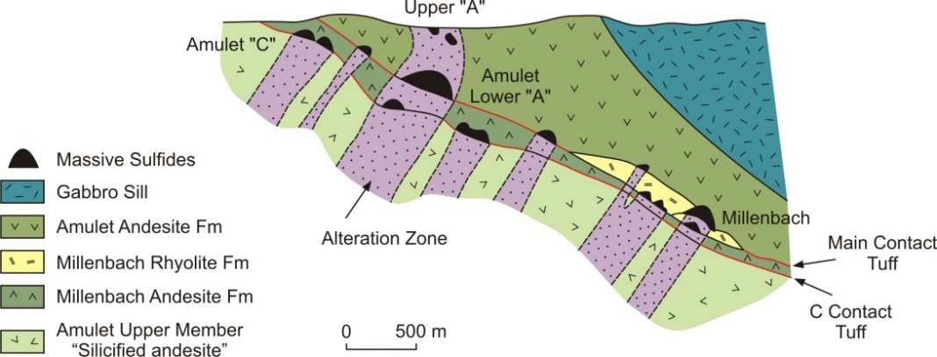
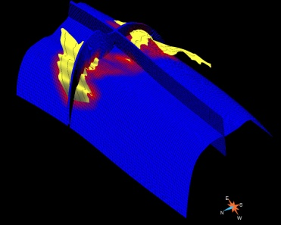
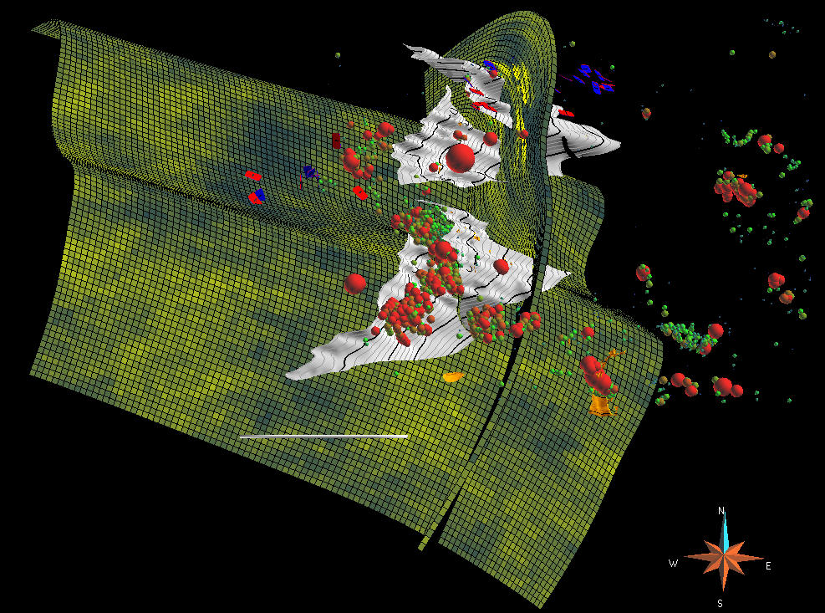
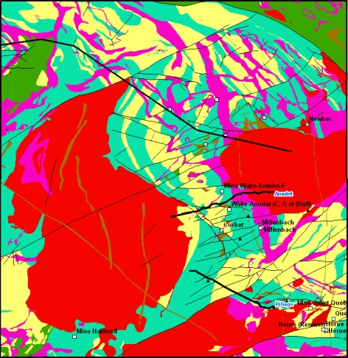
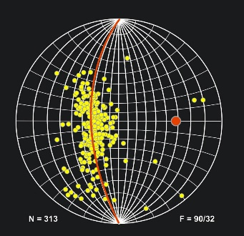
Complex Geology
Model VMS – from Gibson and Galley 2007
Multi-scalar
Non-stationary
Multi-parameter
Stratigraphy + Structure + Properties
Interpreted with Data & Knowledge
C - Contact
Dist to C - Contact
5 km
Horne Mine
Central Camp, Noranda
20th Annual Conference
IAMG2019
State College, Pennsylvania, USA
Simulation (SGS): felsic volcanics, normative corundum, ore bodies

Slide 4
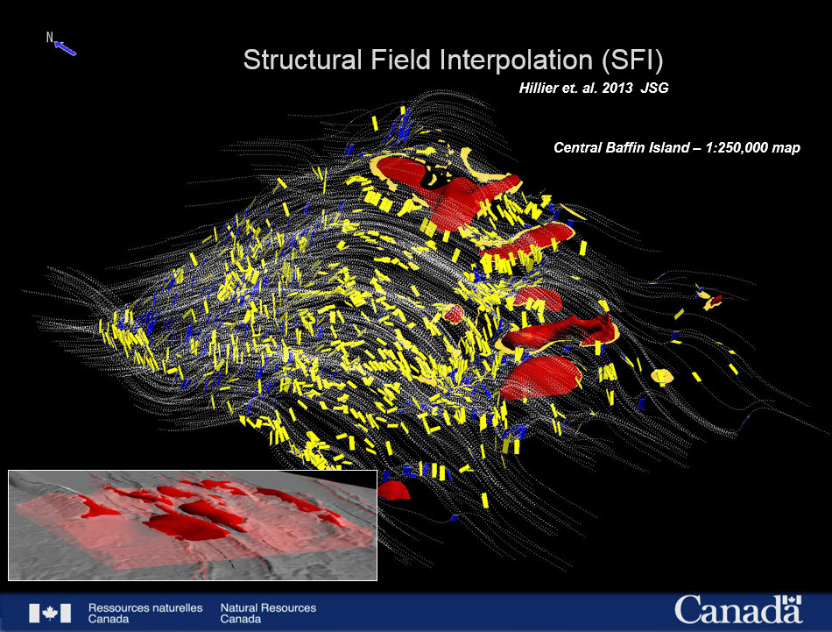
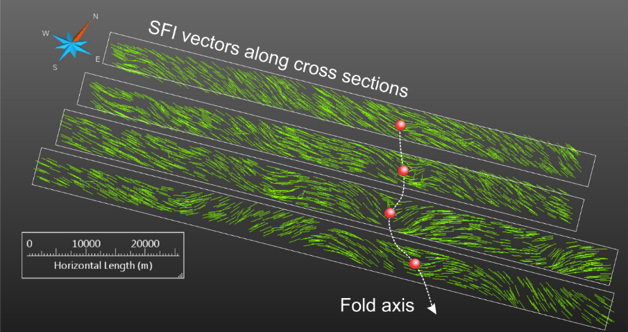
Structural Interpretation
Need 3D fabric visualization (generational)
Support deformation characterization
Need scenario realizations
Utilize legacy / map data
Montsion 2017
~ 50 km
Notes:
Need for methods that can handle extension of contact relations in conformity with regional scale vector fields.

Slide 5

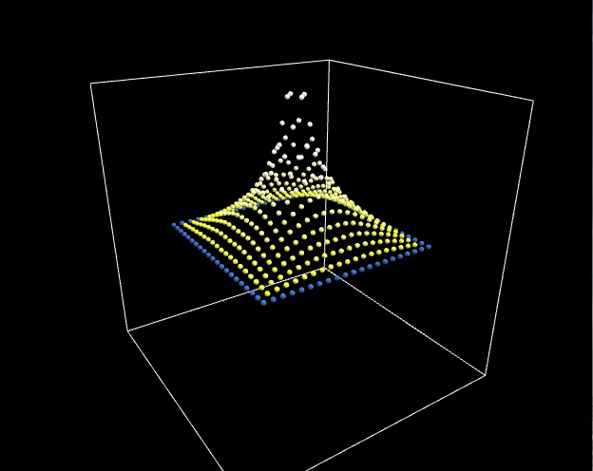
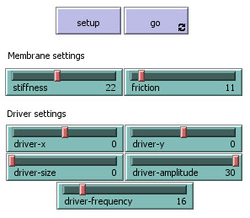
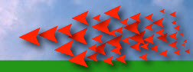
Controlled Randomness
20th Annual Conference
IAMG2019
State College, Pennsylvania, USA
Wilensky, U. , (1996), Wave Machine, http://ccl.northwestern.edu/netlogo/models/WaveMachine3D
Notes:
The spatial agent prototyping environment NETLOGO

Slide 6
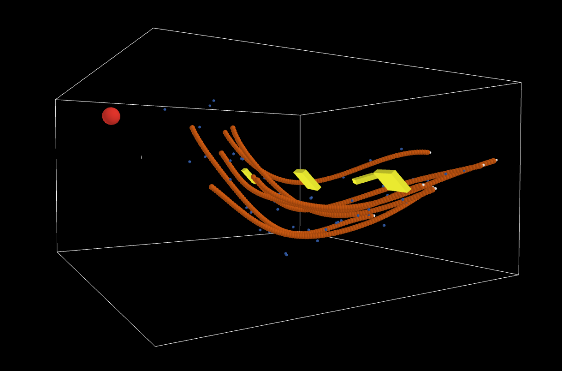
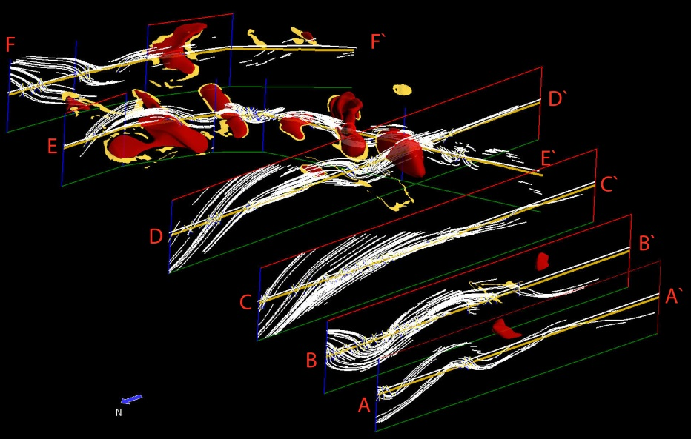
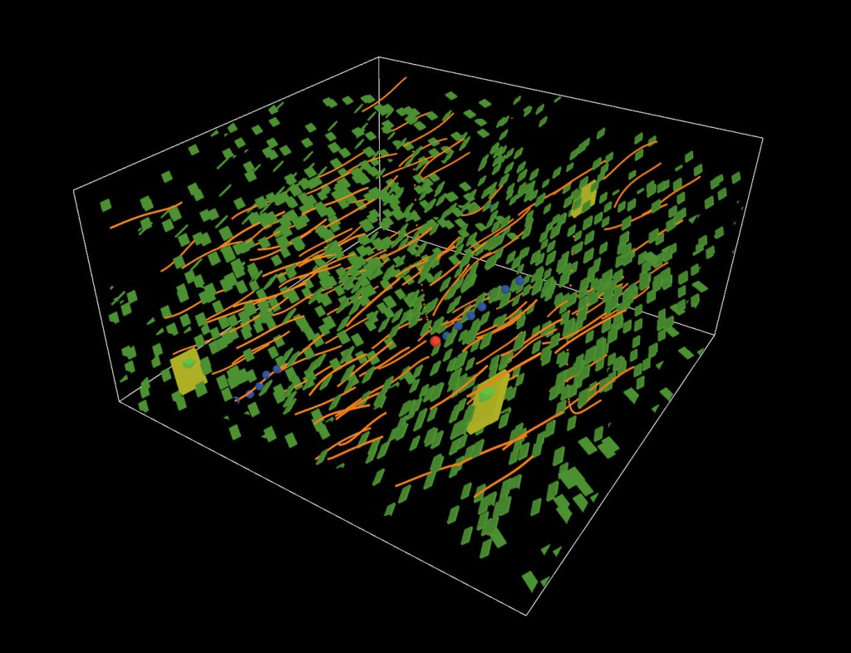
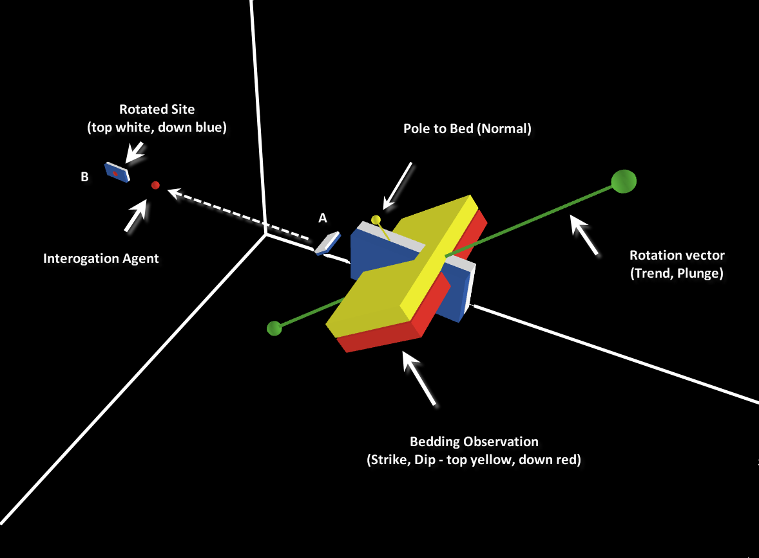
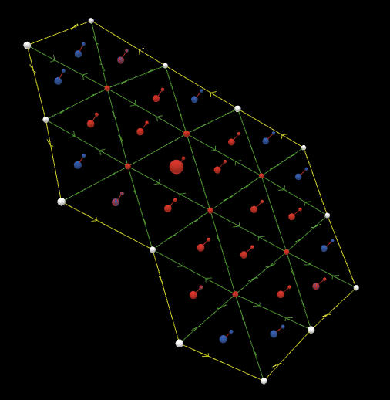
Spatial Agents … for Sparse data modelling

Slide 7
Spatial Agents (SABM)
Good at exploring complex data & space
Efficient at multi-scalar problems
Can have rich domain specific rules – beliefs (Knowledge?)
Can act locally or regionally with Data estimation schemes (Kriging, DSI, GRBF, IDW, SVM, etc. )
Supports complex spatial interaction and communication
Distributed rather then global matrix solver
20th Annual Conference
IAMG2019
State College, Pennsylvania, USA
Notes:
Of interest is to see what others have been doing with natural and artificial complex systems using complexity theory and agent based modelling.
Some interesting qualities of SABM's are that they;
• Can explore all the model space and all the data regardless of how irregular the space is and
how varied or complex the data is. The approach can make many or no solutions, simple or
complex depending on the model design. Generally traditional methods use more regular
partitioned spaces, fixed coordinate systems and one or two geologic parameters.
• More suitable to natural multi-scalar complex systems in which agents can preserve
contributions from all data. This is important as classical techniques generally produce
global means when data is sparse and generalize dense data to a local mean which is often
geologically meaningless. Important in combining geology-structure-geophysics.
• Rich variety of Rules, Missions (Beliefs) and behaviors can be applied while interacting
with and interrogating data thus supporting the interpretive process for the domain expert.
• Many algorithms including classic ones can still be applied (Kriging, DSI Discrete Smooth
Interpolation, RBF Radial Basis Functions, IDW Inverse distance Weighted, SVM Support
Vector Machine, etc. ) at local or regional scales depending on the requirements. Can build on
and compliment rather then replace existing systems.
• Can estimate regional trends and structures that emerge from simple agents interaction with
data. They can estimate complex geometric features or trigger other spatial behaviors
(discontinuities), topologic changes or spawn new agent driven events. Important when
mapping and visualizing complex relationships within vector fields such as fabric
intersections, fold trains, vergence relationships and multiply folded and faulted
stratigraphic boundaries.
• Many smaller matrices drive the agent interaction rather then a single large global matrix.
Agent approach has good optimization potential, it can benefit from faster CPUs and could
potentially be easier to parallelize. Important when combining geophysics and geology.

Slide 8
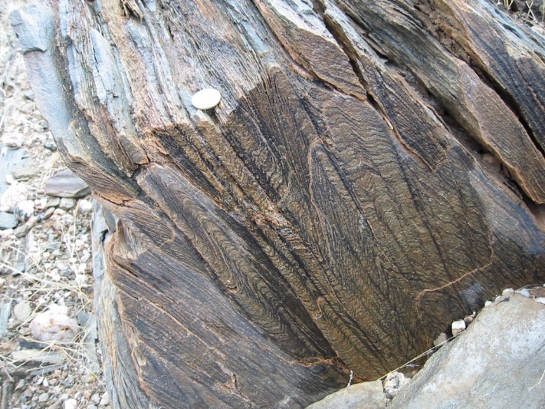
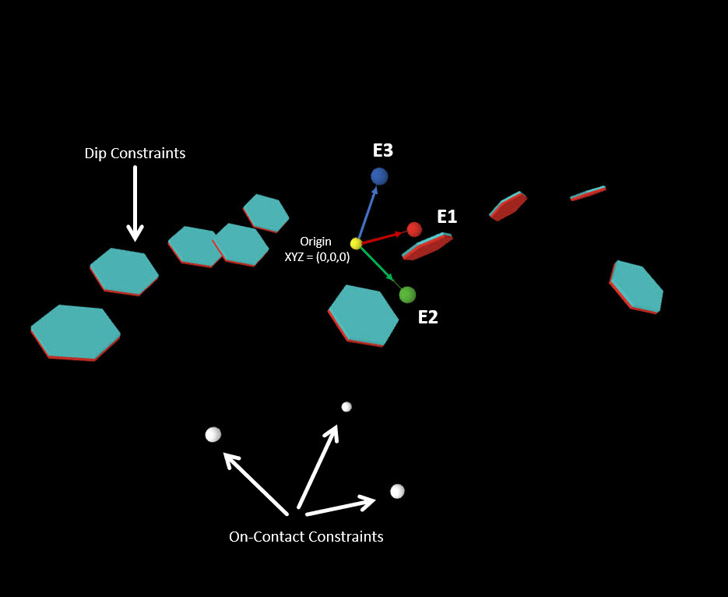

Structural Agents
S2 $∩$ S0/S1
20th Annual Conference
IAMG2019
State College, Pennsylvania, USA
Notes:
Agents could be used to represent constraint data such as structural gradients from deformation generations and the hard constraints from stratigraphic observations.

Slide 9

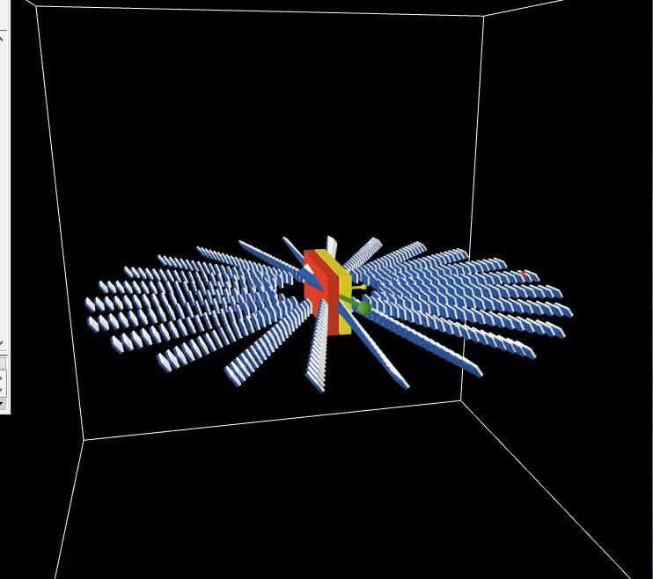
Structural Agents
Rotation of planar and linear elements
Implemented with Quaternion rotation
SLERP (Spherical Linear Interpolation, De Paor 1995)
Interactions with vector field
20th Annual Conference
IAMG2019
State College, Pennsylvania, USA

Slide 10
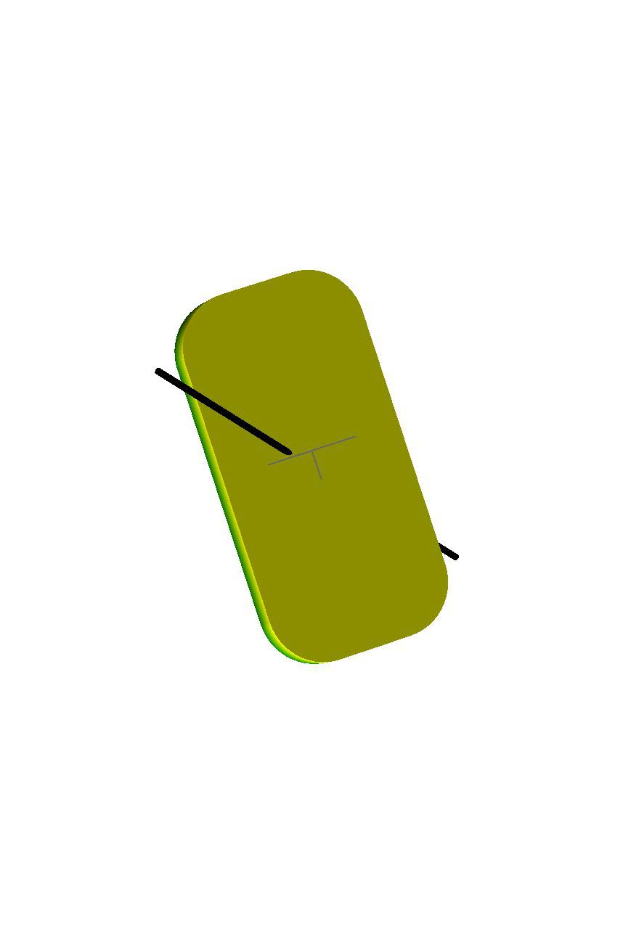
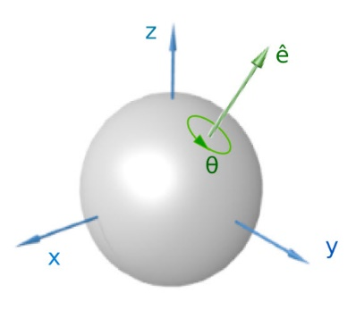
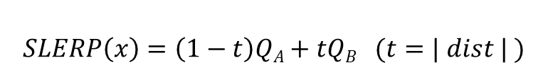
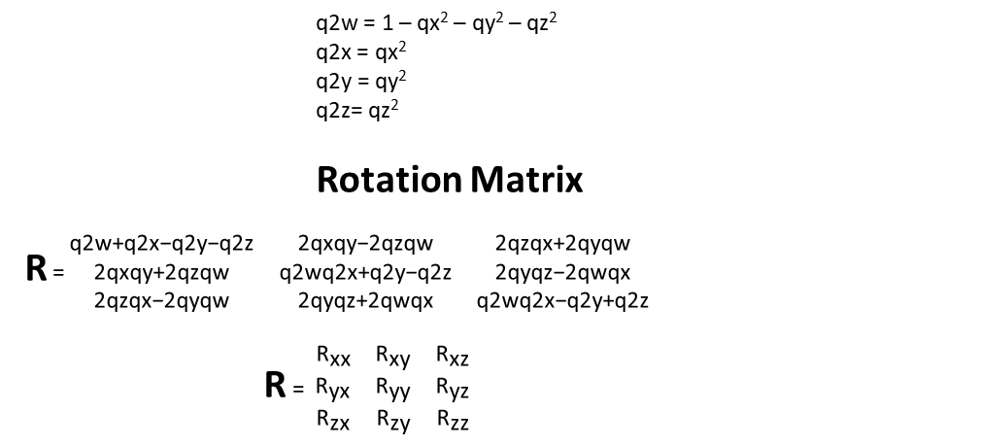
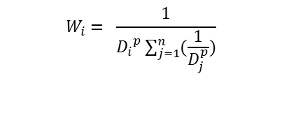

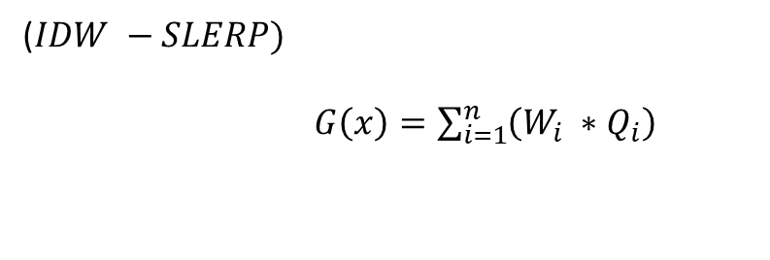
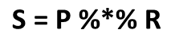
Structural Agents
Spin(A V P) -> S Rotated orientation
A = spherical angle of rotation (not Euler angles!).
V = Unit vector 3D axis of rotation (Vx, Vy, Vz,)
P = Normal unit vector (n_{x}, n_{y}, n_{z}) ie. Poles to beds.
Q = (s, V) scalar , vector
Q = (qw, qx, qy, qz)
qx = ( sin ( A / 2 ) * Vx
qy = ( sin ( A / 2 ) * Vy
qz = ( sin ( A / 2 ) * Vz
qw = ( cos ( A / 2) )
Quaternion Rotation (De Paor 1995, Shoemake 1985, Hamilton 1853)
Q = (s, iV) = (s, i_{x}V_{x}, i_{y}V_{y}, i_{z}V_{z} )
$$\text{S}\text{ = }\text{P}\text{ \%∗\% }\text{R}$$
Q = (qw, qx, qy, qz)
V
$$\text{P}$$
($IDW −SLERP)$
$G\left(x\right)=\sum_{i=1}^{n}{\left(W_{i} ∗Q_{i}\right)}$
q2w = 1 – qx² – qy² – qz²
q2x = qx²
q2y = qy²
q2z= qz²
Rotation Matrix
R =$\begin{matrix}\text{q}\text{2}\text{w}\text{+}\text{q}\text{2}\text{x}\text{−}\text{q}\text{2}\text{y}\text{−}\text{q}\text{2}\text{z} & \text{2}\text{qxqy}\text{−2}\text{qzqw} & \text{2}\text{qzqx}\text{+2}\text{qyqw} \\ \text{2}\text{qxqy}\text{+2}\text{qzqw} & \text{q}\text{2}\text{wq}\text{2}\text{x}\text{+}\text{q}\text{2}\text{y}\text{−}\text{q}\text{2}\text{z} & \text{2}\text{qyqz}\text{−2}\text{qwqx} \\ \text{2}\text{qzqx}\text{−2}\text{qyqw} & \text{2}\text{qyqz}\text{+2}\text{qwqx} & \text{q}\text{2}\text{wq}\text{2}\text{x}\text{−}\text{q}\text{2}\text{y}\text{+}\text{q}\text{2}\text{z}\end{matrix}$
R = $\begin{matrix}{\text{R}}_{\text{xx}} & {\text{R}}_{\text{x}\text{y}} & {\text{R}}_{\text{x}\text{z}} \\ {\text{R}}_{\text{y}\text{x}} & {\text{R}}_{\text{yy}} & {\text{R}}_{\text{yz}} \\ {\text{R}}_{\text{z}\text{x}} & {\text{R}}_{\text{zy}} & {\text{R}}_{\text{zz}}\end{matrix}$
$$W_{i}= \frac{1}{{D_{i}}^{p}\sum_{j=1}^{n}{(\frac{1}{D_{j}^{p}})}}$$
$$SLERP\left(x\right)=\left(1−t\right)QA+tQB (t=| dist | )$$
20th Annual Conference
IAMG2019
State College, Pennsylvania, USA
Notes:
Equations used to calculate Inverse Distance Weighted (IDW) interpolation of Quaternions, essentially a modified linear interpolator SLERP which is a Spherical Linear Interpolator.
William Rowan Hamilton 1853, (1805 – 1865) Lectures on Quaternions, Hodges and Smith, Dublin, Ireland.

Slide 11
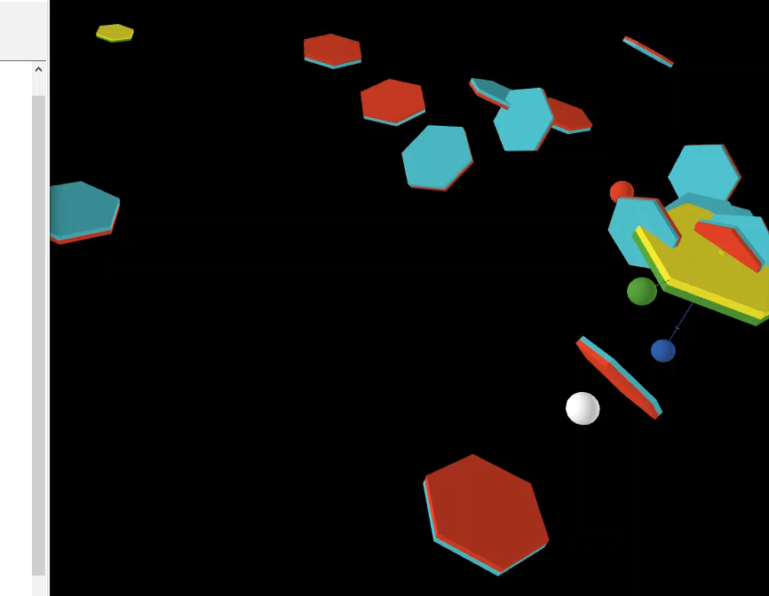
Structural Agents
Simple rotation example
Using modified SLERP with IDW
Dip assigned to on-contact
20th Annual Conference
IAMG2019
State College, Pennsylvania, USA

Slide 12
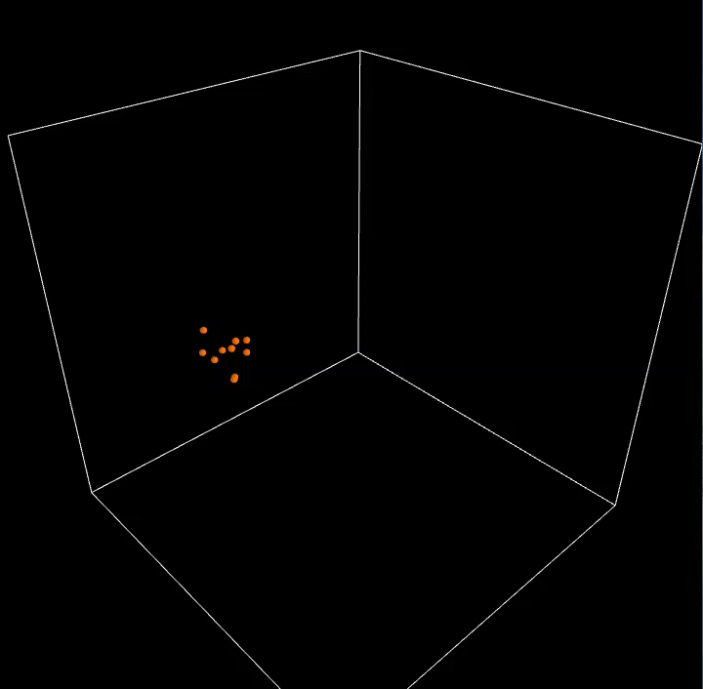
Geometric Construction
Polyhedra construction
Object to object connections
Relationality - topology
20th Annual Conference
IAMG2019
State College, Pennsylvania, USA

Slide 13
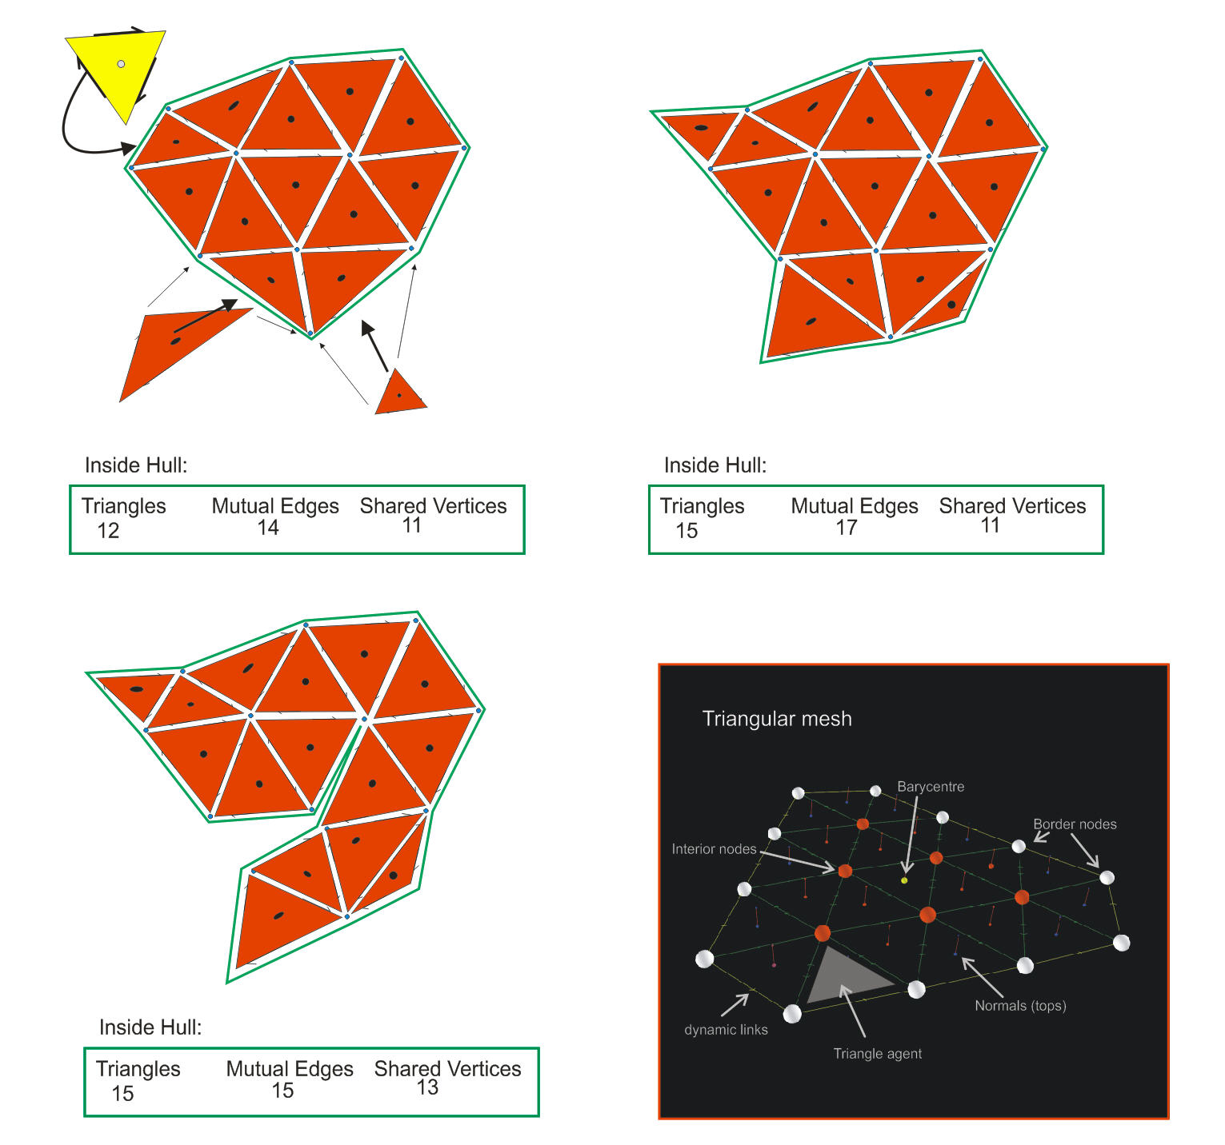
Agent Surface Development
Mesh grows
Maintains polarity
Geometric continuity
Topologic controlled state changes
Agents can act collectively
Primitive adaptive mesh
Notes:
Fundamental to 3D geologic modelling is the work of surface development with computer graphics techniques adapted to geologic applications. Using Spatial Agents to support the modelling process is worth exploring as these examples will demonstrate. Agents can be used to do estimation, interpolation of geologic features but with modification for new rules based on knowledge of the domain. Has potential but more research is needed to determine what kind of geological rule embedding is required (ie. thickness, curvature, shape) and how this is best done without over determining (overfitting) the system.

Slide 14
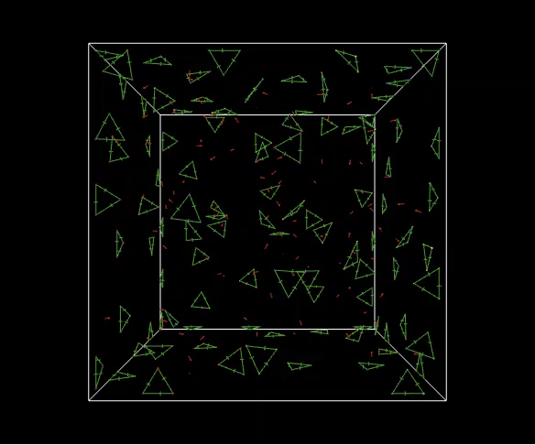
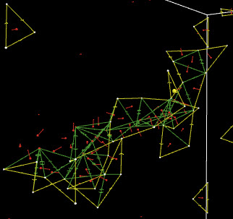
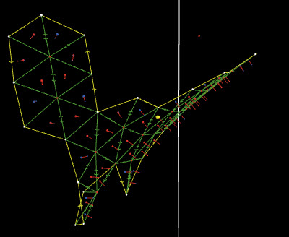
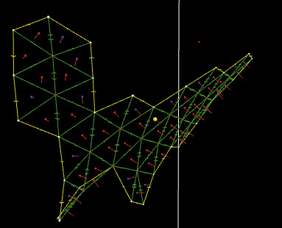
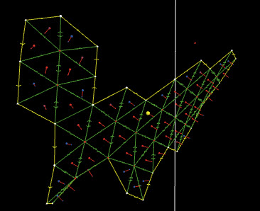
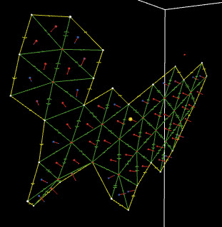
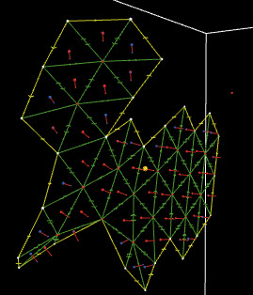
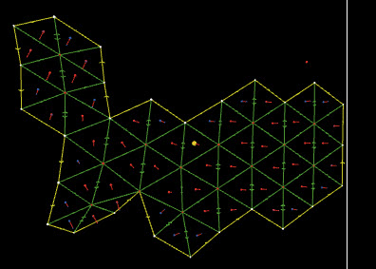
3D Meshing with Agents
20th Annual Conference
IAMG2019
State College, Pennsylvania, USA

Slide 15
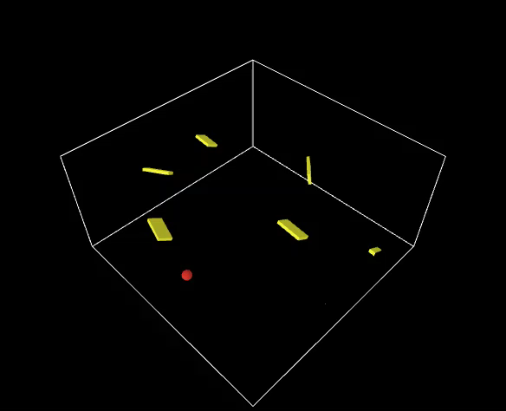

3D Fabric Visualization
Exploration of model space
Embed knowledge criteria
Respects sparse data
Wide model range
20th Annual Conference
IAMG2019
State College, Pennsylvania, USA
Notes:
An example of estimating and representing non-stationary spatial continuity.

Slide 16
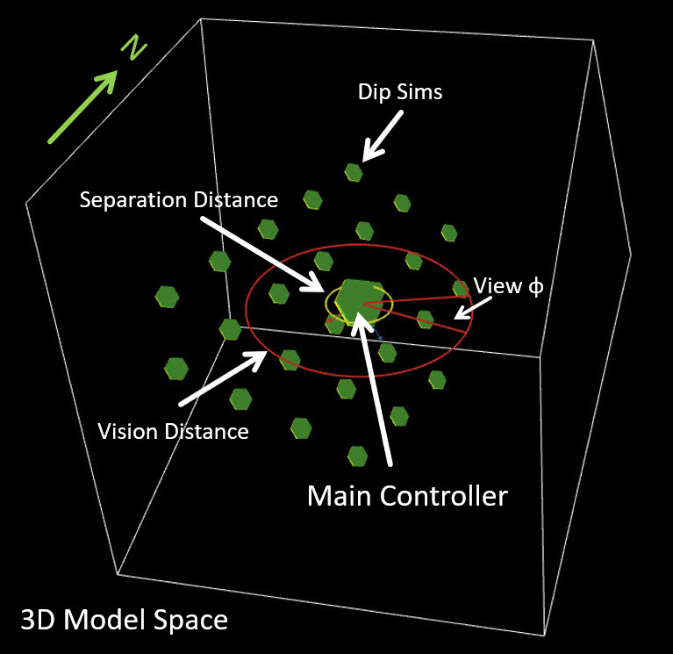
Structural Agents
20th Annual Conference
IAMG2019
State College, Pennsylvania, USA

Slide 17
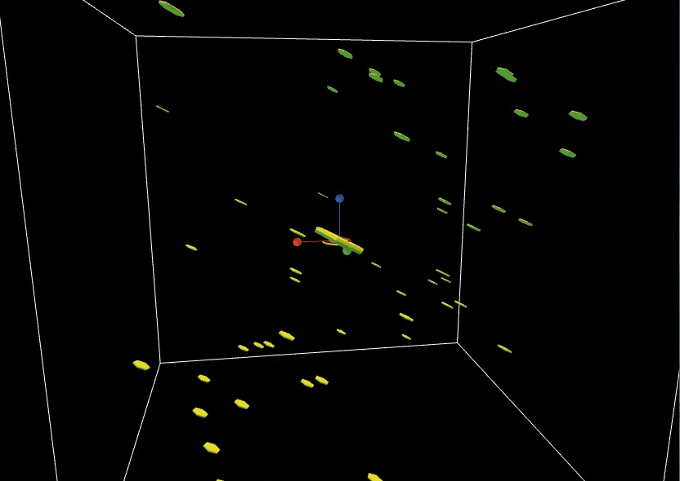
Swarm Behaviour
Spatial interrogation
Vector field analysis
3D Visualization
Meshless (No grid)
No global Matrix
20th Annual Conference
IAMG2019
State College, Pennsylvania, USA
Spatial Agents for Geological Surface Modelling

Slide 18
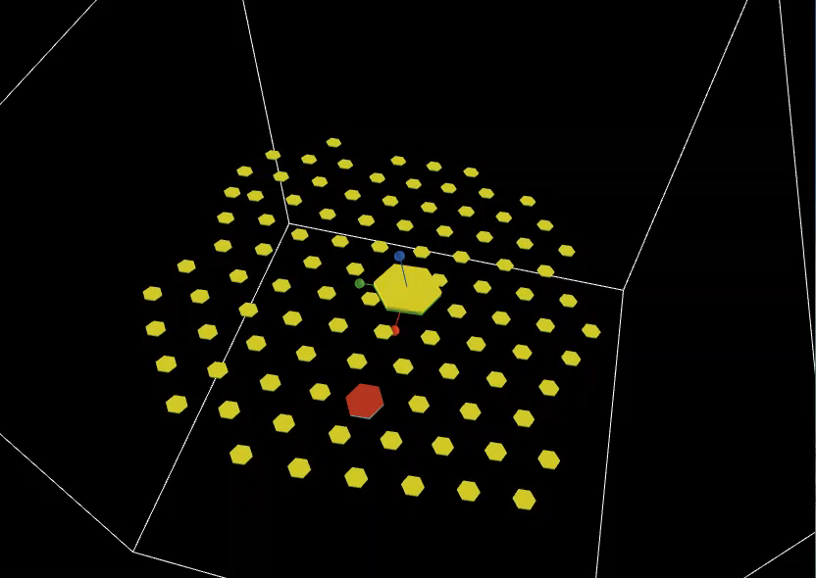
3D Estimation
Structural estimation
IDW + SLERP
Controlled swarm behaviour
20th Annual Conference
IAMG2019
State College, Pennsylvania, USA
Spatial Agents for Geological Surface Modelling

Slide 19
Conclusions
Spatial Agents for Geological Surface Modelling
Spatial Agents have potential for extending sparsely represented features
Are able to model complex structural – vector fields (meshless)
Can be used to construct primitive meshes (Topologic Surfaces)
Worth further testing & development for 3D Geological modelling
20th Annual Conference
IAMG2019
State College, Pennsylvania, USA
*eric.dekemp@canada.ca

Slide 20
Fin! Merci!
Spatial Agents for Geological Surface Modelling
2003 Ugab Fold Belt, Namibia
20th Annual Conference
IAMG2019
State College, Pennsylvania, USA
*eric.dekemp@canada.ca

